Slide 1

Technology in Action
Alan Evans • Kendall Martin
Mary Anne Poatsy
Eleventh Edition
Notes:
Welcome to Chapter 7: Networking: Connecting Computing Devices

Slide 2
Technology in Action
Chapter 7
Networking:
Connecting Computing Devices
Notes:
This chapter discusses connecting computing devices via a computer network.

Slide 3
Chapter Topics
Networking Fundamentals
Network Architectures and Components
Connecting to the Internet
Installing and Configuring Home Networks
Securing Wireless Networks
Notes:
Chapter topics include the following:
Networking Fundamentals
Network Architectures and Components
Connecting to the Internet
Installing and Configuring Home Networks
Securing Wireless Networks

Slide 4
Networking Fundamentals
Computer network
Node
Computer
Peripheral
Network device
Notes:
A computer network is simply two or more computers that are connected via software and hardware so that they can communicate with each other.
Each device connected to a network is referred to as a node.
A node can be a computer, a peripheral such as a printer or game console, or a network device such as a router.

Slide 5
Networking Fundamentals (cont.)
Resource sharing
High-speed Internet connection
Peripheral devices
Files
Common communications
Notes:
There are several benefits to having computers networked:
Sharing an Internet connection: A network lets you share the high-speed Internet connection.
Sharing printers and other peripherals: Networks let you share peripheral devices.
Sharing files: You can share files between networked computers without having to use portable storage devices. In addition, you can set sharing options in Windows or OS X that let the user of each computer on the network access files stored on any other computer on the network.
Common communications: Computers running different operating systems can communicate on the same network.

Slide 6
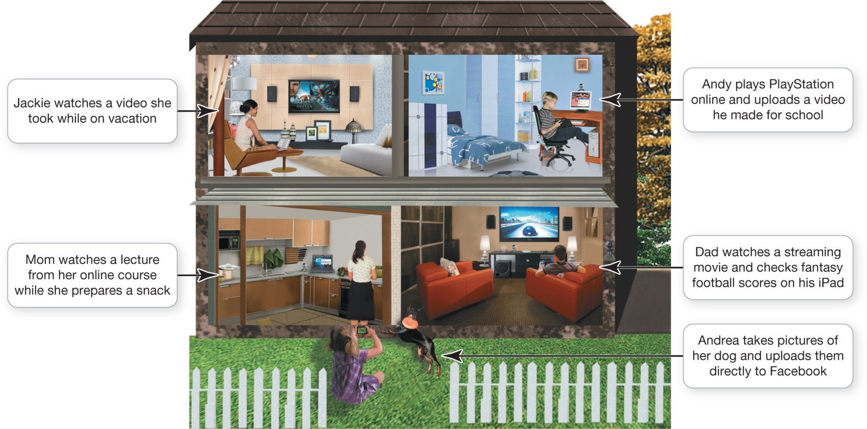
Networking Fundamentals (cont.)
Notes:
With a home network, all family members can connect their computing devices whenever and wherever they want.

Slide 7
Networking Fundamentals (cont.)
Home networks
Large networks
Purchase of equipment
Network administration
Benefits usually outweigh disadvantages
Notes:
Fortunately, after most home networks have been set up, there isn’t much else that needs to be done to maintain or administer the network; therefore, the benefits of using a network outweigh the disadvantages.
However, large networks involve an initial purchase of equipment to set them up. They also need to be administered, which can be costly and time-consuming. Network administration involves tasks such as:
Installing new computers and devices
Monitoring the network to ensure it’s performing efficiently
Updating and installing new software on the network
Configuring, or setting up, proper security for a network

Slide 8
Networking Fundamentals (cont.)
Data transfer rate (bandwidth)
Throughput
Measured in megabits per second (Mbps)
Notes:
Data transfer rate (also called bandwidth) is the maximum speed at which data can be transmitted between two nodes on a network.
Throughput is the actual speed of data transfer that is achieved.
Throughput is always less than or equal to the data transfer rate. Data transfer rate and throughput are usually measured in megabits per second (Mbps). A megabit is 1 million bits.

Slide 9
Network Architectures
Classified by:
Distance between nodes
How they are managed
Rules used to exchange data between nodes
Communications medium used
Notes:
The network you have in your home differs greatly in terms of its size, structure, and cost from that found across your college campus. This difference is based in part on their network architectures.
Network architectures, or network designs, are classified according to the following characteristics:
The distance between their nodes
The way in which they are managed (or administered)
The set of rules (or protocol) used to exchange data between network nodes
The communications medium used to transport the data

Slide 10
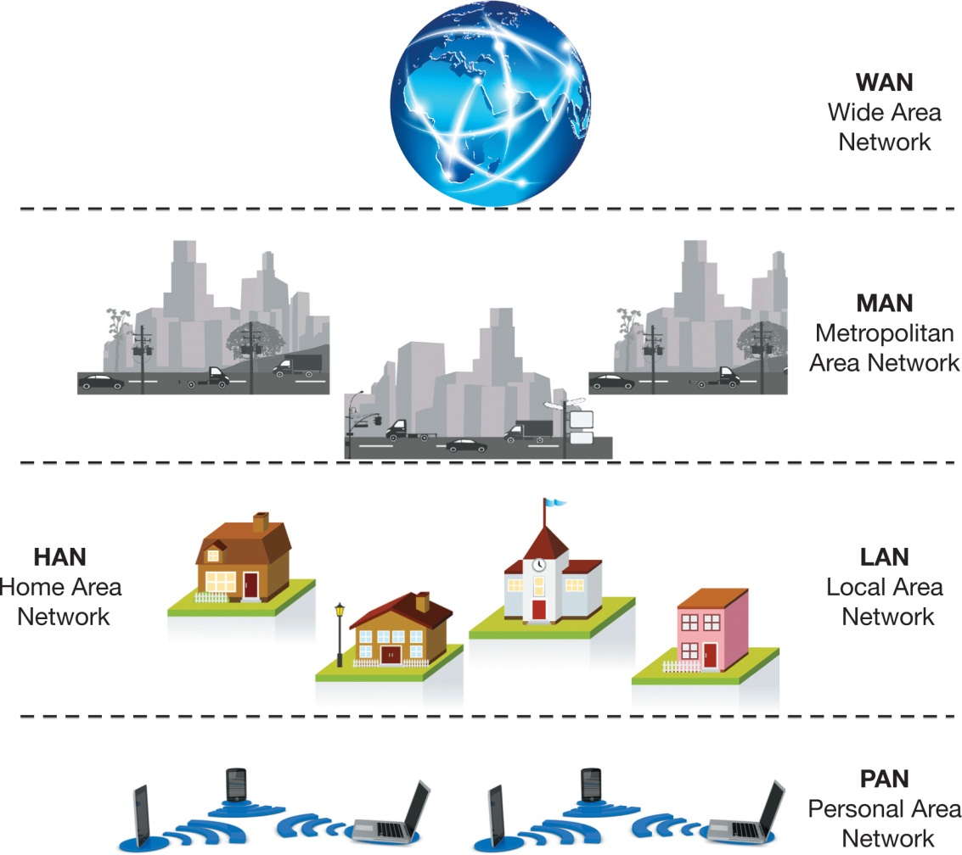
Network Architectures: Defined by Distance
Distance between nodes
Notes:
The distance between nodes on a network is one way to describe a network.

Slide 11
Network Architectures: Defined by Distance
Personal area network (PAN)
Local area network (LAN)
Home area network (HAN)
Notes:
A personal area network (PAN) is a network used for communication among devices close to one person, such as smartphones, notebooks, and tablets, using wireless technologies such as Bluetooth and WiFi.
A local area network (LAN) is a network in which the nodes are located within a small geographic area. Examples include a network in a computer lab at school or at a fast-food restaurant.
A home area network (HAN) is a LAN located in a home. HANs are used to connect all digital devices, such as computers, peripherals, phones, gaming devices, digital video recorders (DVRs), and televisions.

Slide 12
Network Architectures: Defined by Distance (cont.)
Metropolitan area network (MAN)
Wide area network (WAN)
Notes:
A metropolitan area network (MAN) is a large network designed to provide access to a specific geographic area. Many U.S. cities are now deploying MANs to provide Internet access to residents and tourists.
A wide area network (WAN) spans a large physical distance. The Internet is the largest WAN. A WAN is also a networked collection of LANs. If a school has multiple campuses, each with its own LAN, connecting the LANs of each campus by telecommunications lines allows the users of the LANs to communicate. All the connected LANs would be described as a single WAN.

Slide 13
Network Architectures: Defined by Level of Administration
Administered in one of two ways
Central administration
Local administration
Notes:
A network can be administered either centrally or locally.
Central administration: In a centrally administered network, tasks performed from one computer can affect the other computers on the network. A client/server network is an example. In this setup, a client is a computer on which users accomplish tasks and make requests and the server is the computer that provides information or resources.
Local administration: In a locally administered network, the configuration and maintenance of the network must be performed on each individual computer. A peer-to-peer (P2P) network is an example where each node can communicate directly with every other node.

Slide 14
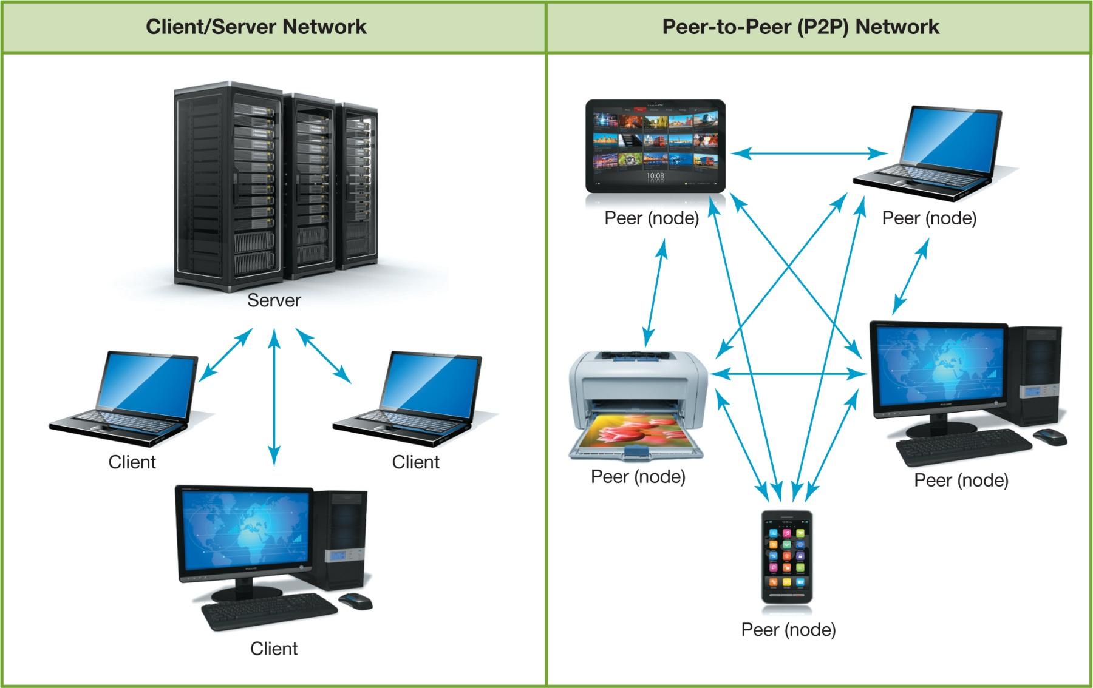
Network Architectures: Defined by Level of Administration
Notes:
This figure shows Client/Server and P2P Networks.

Slide 15
Network Architectures: Ethernet Protocols
Ethernet network
Ethernet protocol for communication
Developed by the Institute of Electrical and Electronics Engineers (IEEE)
802.3
802.11
Notes:
An Ethernet network is so named because it uses the Ethernet protocol as the means by which the nodes on the network communicate.
The Ethernet protocol was developed by the Institute of Electrical and Electronics Engineers (IEEE).
The standard for wired Ethernet networks is 802.3. The standard for wireless Ethernet networks, also known as wireless fidelity (WiFi), is 802.11.
The current wireless Ethernet standard, 802.11ac, is faster and has a better signal range than the earlier 802.11n standard.

Slide 16
Network Architectures: Ethernet Protocols (cont.)
802.11n devices will work with 802.11ac networks
Backward compatibility
Notes:
Devices using older standards, such as 802.11n, will still work with 802.11ac networks, but they will operate with slower data transfer rates and may run into some frequency interference. The ability of current devices to use earlier standards in addition to the current standard is known as backward compatibility.

Slide 17
Network Architectures: Ethernet Protocols (cont.)
Gigabit Ethernet Standard
Up to 1 gigabit per second (Gbps) data transfer rate
10 gigabit Ethernet is available
Notes:
The most commonly used wired Ethernet standard for home networks is the gigabit Ethernet standard. A data transfer rate of up to 1 giagbit per second (Gbps) is possible using this standard. Computers generally ship with gigabit Ethernet cards installed.
For even faster data transfer speeds, 10 gigabit Ethernet is available. It provides a maximum data transfer rate of 10 Gbps. But 10-gigabit Ethernet networks are primarily used in businesses with large data throughput needs.

Slide 18
Network Components
All networks must include:
Means of connecting nodes to network
Cables or wireless
Special devices that allow nodes to communicate
Software
Notes:
To function, all networks must include:
A means of connecting the nodes on the network (cables or wireless technology)
Special hardware devices that allow the nodes to communicate with each other and to send data
Software that allows the network to run

Slide 19
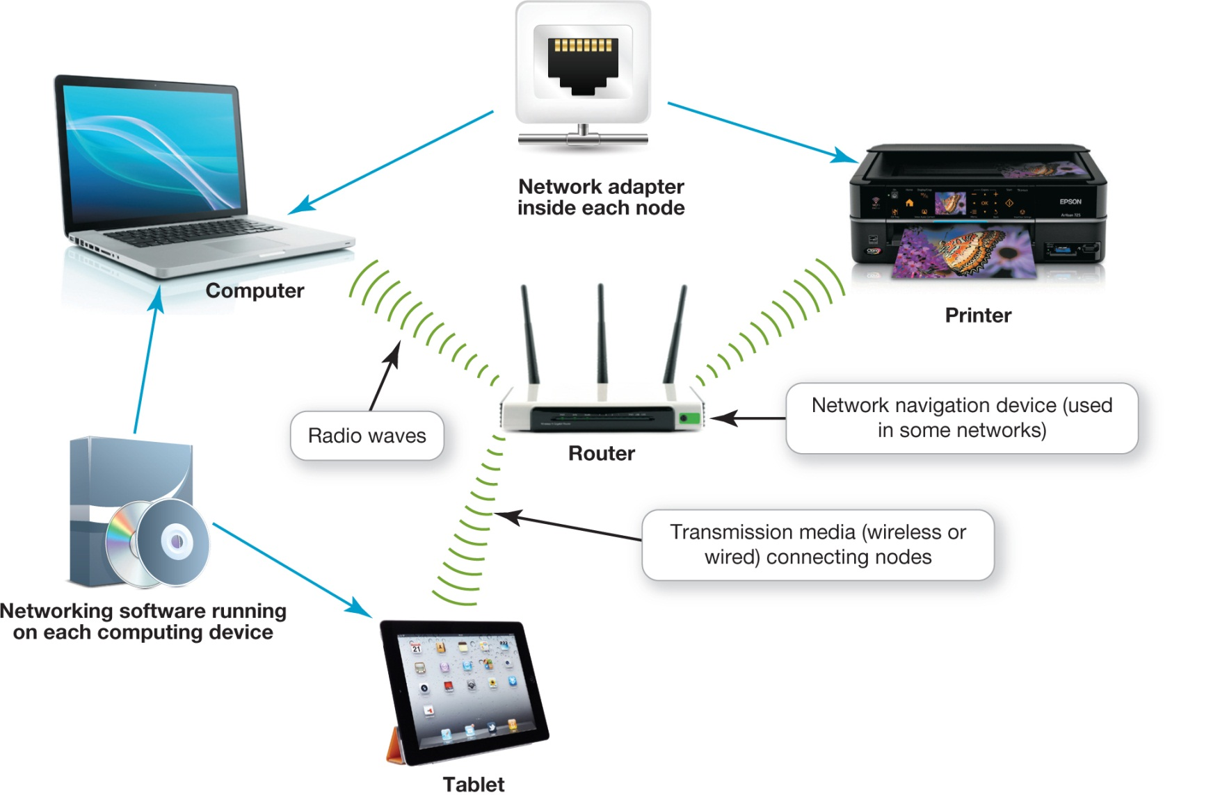
Network Components (cont.)
Notes:
This figure shows network components.

Slide 20
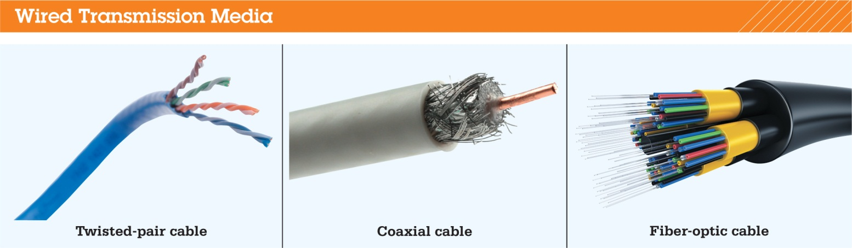
Network Components: Transmission Media
Communications channel between nodes
Wireless networks
Radio waves
Wired networks
Cables
Notes:
All network nodes are connected by transmission media that can be wired or wireless. They establish communication channels between nodes.
The type of network and the distance between nodes determines the type of cable used:
Twisted-pair cable is made up of copper wires that are twisted and surrounded by a plastic jacket. A slightly different type, called unshielded twisted pair (UTP) cable, is used is used for networks.
Coaxial cable consists of a single copper wire surrounded by layers of plastic.
Fiber-optic cable is made up of plastic or glass fibers that transmit data at extremely fast speeds.

Slide 21
Network Components: Transmission Media (cont.)
UTP cable
Types of UTP cable
Cat 5E
Cat 6
Cat 6a
Notes:
The most popular transmission media option for wired Ethernet networks is UTP cable.
The three main types of UTP cable are:
Cat 5E: It was designed for 100 Mbps – wired Ethernet networks that were popular before gigabit Ethernet networks became the standard.
Cat 6: It’s probably the best choice for a home networking cable.
Cat 6a: Cat 6a cable is designed for ultra-fast Ethernet networks that run at speeds as fast as 10 Gbps. Installing a 10-gigabit Ethernet network in the home is probably unnecessary because today’s home applications don’t require this rate of data transfer.

Slide 22
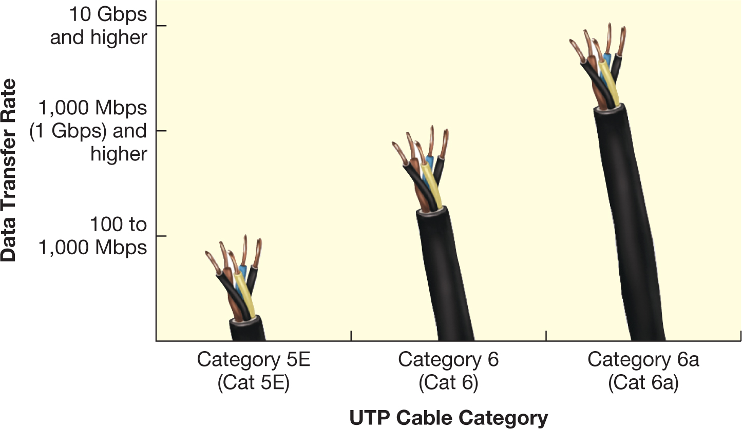
Network Components: Transmission Media (cont.)
Notes:
The three main UTP cable types used in home networks have different data transfer rates.

Slide 23
Network Components: Transmission Media (cont.)
Decreased throughput in wireless networks
Magnetic and electrical sources
Other wireless networks
Buildings and metal
Distance
Signal coding
Notes:
Wireless networks generally have decreased throughput compared with that of wired networks.
Here are some reasons why:
Wireless signals are more susceptible to interference from magnetic and electrical sources.
Other wireless networks can interfere with the signals on your network.
Certain building materials (e.g., concrete and cinderblock) and metal (e.g., a refrigerator) can decrease throughput.
Throughput varies depending on the distance between your networking equipment.
Wireless networks usually use specially coded signals to protect their data, whereas wired connections don’t protect their signals. This process of coding signals can slightly decrease throughput, although once coded, data travels at usual speeds.

Slide 24
Network Components: Transmission Media (cont.)
Network can be both wireless and wired
Portable devices—wireless
Stationary devices—usually wired
Wired connections are faster
Notes:
One network can support nodes with both wireless and wired connections. Most people use wireless connections for portable devices such as laptops.
Many of the devices connected to a network, such as printers and TVs, usually stay in one location, so hooking them up to wired connections lets you take advantage of the faster throughput achieved by wired connectivity.

Slide 25
Network Components: Basic Network Hardware
Network adapter
Network interface card (NIC)
Broadband Internet
Requires a modem
Cable or DSL
Translates the broadband signal
Notes:
For the nodes on a network to communicate with each other and access the network, each node needs a network adapter. All desktop and laptop computers as well as smartphones, tablets, and many peripherals sold today contain network adapters installed inside the device. This type of integrated network adapter is referred to as a network interface card (NIC). Different NICs are designed to use different types of transmission media.
A broadband Internet connection requires a modem. Depending on the type of service you have, you’ll have either a cable modem or a DSL modem. The modem translates the broadband signal.

Slide 26
Network Components: Basic Network Hardware (cont.)
Packets
Communication
Flow between network nodes
Notes:
Data is sent through a network in bundles called packets. For computers to communicate, these packets of data must be able to flow between network nodes.

Slide 27
Network Components: Basic Network Hardware (cont.)
Router
Switch
Notes:
Network navigation devices facilitate and control the flow of data through a network.
A router transfers packets of data between two or more networks. On a home network, you need a router to transfer data between your network and the Internet, which is considered a separate network. To add WiFi to your home network, you need a router that features wireless capabilities.
A switch acts like a traffic signal on a network. All routers sold for home use have integrated switches. Switches receive data packets and send them to their intended nodes on the same network (not between different networks).

Slide 28
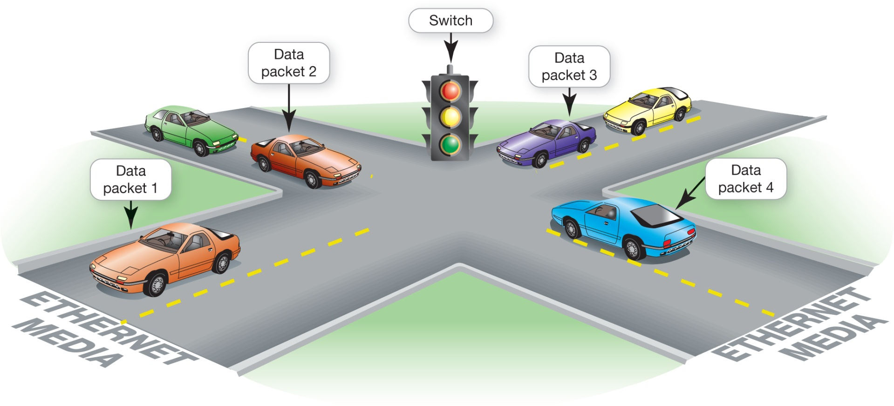
Network Components: Basic Network Hardware (cont.)
Notes:
This figure shows a simplified explanation of the function of switches: that, together with NICs, they act like traffic signals or traffic cops. They enforce the rules of the data road on an Ethernet network and help prevent data packets from crashing into each other.

Slide 29
Network Components: Basic Network Hardware (cont.)
Router
Connected directly to modem
All other devices connected to the router
Wired or wireless
Notes:
Your router should be connected directly to your broadband (cable/DSL) modem. The connection should be an Ethernet cable running from an Ethernet port on your modem to the modem port on your router. Then, all computing devices—such as an HDTV, a tablet, and a laptop—are connected to the router via a wired or wireless connection. Some routers have integrated modems so that you only need one device.

Slide 30
Network Components: Network Software
Operating software for P2P networking
Client/server network
Communicate through centralized server
Specialized network operating system (NOS) software
Notes:
Home networks are P2P networks so need operating systems that supports P2P networking.
As opposed to P2P networks, the nodes on a client/sever network don’t communicate directly with each other. They communicate through a centralized server. Communicating through a server is more efficient with a large number of nodes, but it requires more complex software than is necessary for P2P networks. Servers on client/server networks have specialized network operating system (NOS) software. The software handles requests for information, Internet access, and the use of peripherals. Examples of NOS software include Windows Server and SUSE Linux Enterprise Server.

Slide 31
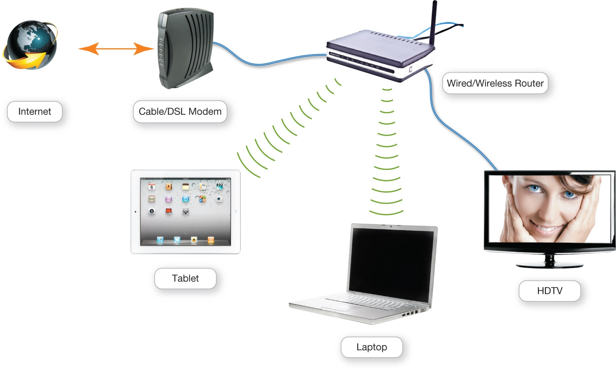
Network Components Network Software
Notes:
This figure shows a small network with a wired/wireless router attached.

Slide 32
Connecting to the Internet
Home network
Share an Internet connection
Must purchase Internet access from ISP
Specialized providers
Companies that provide other services
Notes:
One of the main reasons for setting up a network is to share an Internet connection. Some businesses and large organizations have a dedicated connection to the Internet, but other businesses and homeowners purchase Internet access from Internet service providers (ISPs). ISPs might be specialized providers, like Juno, or companies like Comcast that provide additional services, such as phone and cable TV.

Slide 33
Connecting to the Internet (cont.)
Connection choices
Broadband
Dial-up
Notes:
Broadband is the preferred way to access the Internet, but in some situations cellular or dial-up access might be necessary.

Slide 34
Connecting to the Internet Wired Broadband Connections
Broadband
High-speed Internet
Data transmission rate of 5 Mbps or greater
Standard wired broadband technologies
Cable
Digital subscriber line (DSL)
Fiber optic service
Notes:
Broadband, often referred to as high-speed Internet, refers to a type of connection that offers a faster means to connect to the Internet with faster throughput. Broadband usually has a data transmission rate of 1 – 50 Mbps. This high rate of access is in contrast to dial-up Internet access, which has a maximum transmission speed of 56 Kbps (kilobits per second).
The standard wired broadband technologies in most areas are cable, DSL (digital subscriber line), and fiber optic service.

Slide 35
Connecting to the Internet” Wired Broadband Connections (cont.)
Satellite broadband
Mobile broadband
Notes:
Satellite broadband is used mostly in rural or mountain areas that can’t get DSL, cable, or fiber optic service.
There are also wireless broadband options. Mobile broadband is offered through many cell phone service providers through 3G and 4G networks. Wireless Internet (WiFi) is also available via WiFi radio waves.

Slide 36
Connecting to the Internet: Wired Broadband Connections (cont.)
Cable Internet
DSL
Fiber optic service
Notes:
Cable Internet is a broadband service that transmits data over the coaxial cables that also transmit cable television.
DSL (digital subscriber line) uses twisted-pair cable to connect your computer to the Internet. The bandwidth of the wires is split into three sections. One is used to carry voice data. DSL uses the remaining two lanes to send and receive data.
Fiber optic service uses fiber optic lines, which are strands of optically pure glass or plastic that are as thin as a human hair. They’re arranged in bundles called optical cables and transmit data via light signals over long distances.

Slide 37
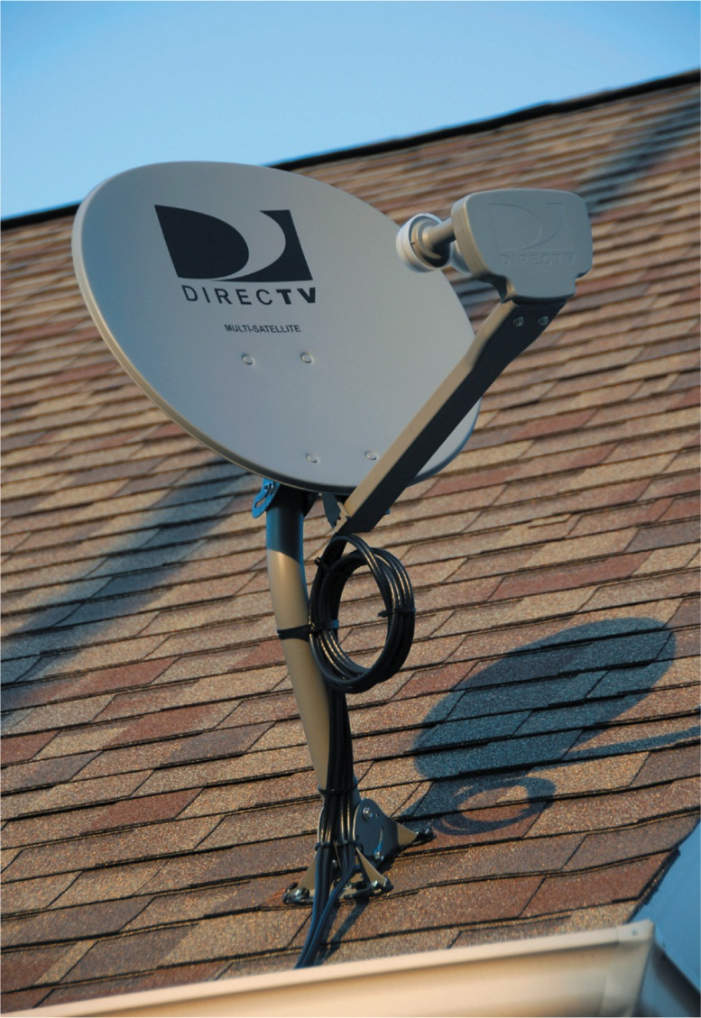
Connecting to the Internet: Wired Broadband Connections (cont.)
Satellite Internet
Notes:
To take advantage of satellite Internet, you need a satellite dish, which is placed outside your home and connected to your computer with coaxial cable, the same type of cable used for cable TV. Data from your computer is transmitted between your personal satellite dish and the satellite company’s receiving satellite dish by a satellite that sites in a geosynchronous orbit thousands of miles above the Earth.

Slide 38
Connecting to the Internet: Wireless Internet Access
Wireless Internet at home
Router with wireless capabilities
Built in WiFi on devices
Laptops, smartphones, game systems, and personal media players
Notes:
To access the Internet wirelessly at home, you need to establish WiFi on your home network by using a router that features wireless capabilities. You also need the right equipment on your mobile device.
Virtually all laptops, smartphones, game systems, and personal media players sold today are WiFi-enabled and come with built-in wireless capability.

Slide 39
Connecting to the Internet: Wireless Internet Access (cont.)
WiFi hotspot
Wireless in-flight Internet
Gogo
Notes:
When you’re away from home, you might need a WiFi hotspot. Many public places offer WiFi access. You can also sign up for 3G or 4G Internet access with a cell phone provider.
Websites like Wi-Fi-FreeSpot (wififreespot.com) and Wi-Fi Planet (wi-fiplanet.com) help you locate a free hotspot wherever you’re planning to go.
Even wireless in-flight Internet service is available. Gogo (gogoair.com) is a wireless broadband network that provides coverage on participating airlines across the continental United States. So when you are cleared to use your portable electronic devices, you can comfortably access wireless Internet from 35,000 feet.

Slide 40
Connecting to the Internet: Wireless Internet Access (cont.)
Mobile broadband
3G or 4G capabilities
Notes:
Mobile broadband connects you to the Internet through the same cellular network that cell phones use to get 3G or 4G Internet access.
3G and 4G can be thought of as “WiFi everywhere” in that they provide Internet access to your mobile devices in the same way they provide voice service. 3G and 4G refer to the third and fourth generations, respectively, of cell phone networks.
4G is the latest service standard and offers the fastest data access speeds.
To utilize the 3G or 4G capabilities, you need to sign up for an access plan with a mobile data provider.

Slide 41
Connecting to the Internet: Wireless Internet Access (cont.)
Mobile Broadband 3G
3 Mbps
4G from a fixed location
1 Gbps
4G LTE
Support less than 1 Gbps
Notes:
Mobile broadband Internet such as 3G performs similarly to a standard DLS connection (roughly 3 Mbps).
According to the standards set for 4G, the data transfer rate you would get while in a moving vehicle is approximately 100 Mbps; from a fixed location, you can expect up to a 1 Gbps data transfer rate.
Some of the early 4G systems released in the market support less than the required 1 Gbps rate and are not fully compliant with 4G standards, and so are being tagged as 4G LTE. They are still faster than 3G, however.

Slide 42
Connecting to the Internet: Wireless Internet Access (cont.)
3G or 4G capabilities
Built in on many devices
USB modem is available
Mobile hotspot
Notes:
Many devices such as the iPad, Kindle Fire, Chromebook, and some laptops are available with built-in 3G or 4G capabilities. If your device doesn’t have built-in 3G or 4G equipment, you can buy a USB modem. Like a smartphone, they require a service plan.
Instead of buying a USB modem that works on one device, you can buy a mobile hotspot. These mobile hotspots let you connect more than one device to the Internet with either WiFi or mobile broadband. Mobile hotspots also require a data plan, but the monthly fee might be less than paying for individual plans.

Slide 43
Connecting to the Internet: Dial-Up Connections
High-speed
70% of Internet users
Dial-up connection
No high-speed service available
Least costly
Slow speed
Notes:
Although about 70 percent of Internet users in the United States use high-speed Internet connections, there are still some areas where broadband service isn’t available. A dial-up connection requires a standard phone line and a modem to access the Internet.
Some people choose to use a dial-up connection when there’s no high-speed service in their area. Also, a dial-up connection is the least costly way to connect to the Internet.
The major downside to dial-up is speed. Dial-up modems transfer data 600 times slower than a fiber optic broadband connection.

Slide 44
Installing and Configuring Home Networks
Home networks
Smartphones
Gaming consoles
Tablets
Smart TVs
Computers
Printers
Notes:
Now that you understand the basic components of a home network and your Internet connection options, you’re ready to install a network in your home.
Only a few years ago, most home networks included just a few computers and a printer. However, a network that can manage those devices is often very different from one that can support the smartphones, gaming consoles, tablets, and smart TVs many homes have added to their networks since.

Slide 45
Installing and Configuring Home Networks: Planning Your Home Network
Setting up a home network
Evaluate your devices
Use the latest wireless Ethernet standard
Current Ethernet standard: 802.11ac
Notes:
When setting up a home network first you should evaluate all the devices you’re using or might add.
For a home network to run efficiently and fast, it’s best that all network nodes use the latest wireless Ethernet standard.
Devices that support the 802.11n standard have been around for a while. The newest wireless standard is 802.11 ac.
Your router might still be supporting the 802.11n standard. If you have the fastest 802.11ac NIC in your laptop, but the router is the 802.11n standard, then data will be sent at the speeds of the lower standard.

Slide 46
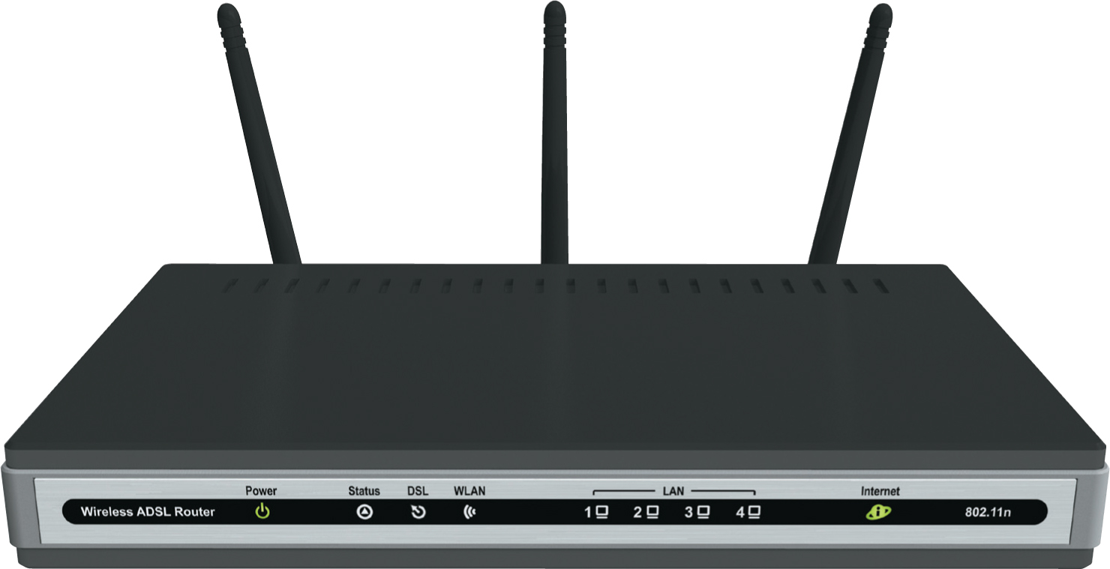
Installing and Configuring Home Networks: Planning Your Home Network
Notes:
An 802.11ac wireless routers offer the fastest connection speeds and a greater wireless signal range.

Slide 47
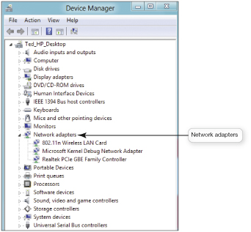
Installing and Configuring Home Networks: Planning Your Home Network (cont.)
Device Manager
Notes:
You might be able to tell whether your router is supporting the faster 802.11ac standard just by looking at it. Many routers have the wireless standard indicated on the devices. If you’re still not sure, you can search for more information on your router by entering the model number into a search engine.
To see which network adapters are installed in your Windows computer, use the Device Manager utility, which lists all the adapters. If you can’t tell which wireless standard the adapter supports from the list, search the Internet for information on your specific adapter to determine its capability.

Slide 48
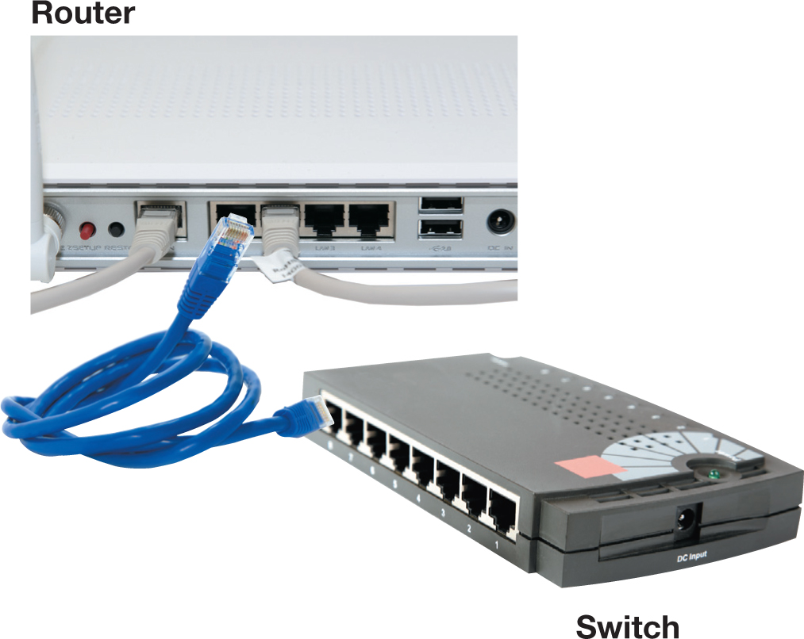
Installing and Configuring Home Networks: Connecting Devices to a Router
Notes:
Most home routers have three or four Ethernet ports to support wired connections. If you need additional ports, you can buy a standalone switch and plug that into one of the ports on your router.
Don’t mistakenly buy another router with an embedded switch and try adding that to your network. The two routers will cause conflicts.
Most home wireless routers can support up to 253 wireless connections at the same time.
Regardless of how many devices your home network has, they all share bandwidth when they’re connected to a router.

Slide 49
Installing and Configuring Home Networks: Connecting Devices to a Router (cont.)
All 802.11n routers should work with Windows or OS X
Routers for Apple computers
AirPort Extreme router
Windows machines can also connect
Notes:
All routers that support the 802.11n standard should work with computers running Windows or OS X. However, Apple has designed routers that are optimized for working with Apple computers. So if you’re connecting Apple computers to your network, you might want to use the Apple AirPort Extreme router.
Windows machines can also connect to an AirPort router, so it’s a great choice for households with both Apples and PCs. It uses the newest 802.11ac technology for the fastest data transfers.

Slide 50
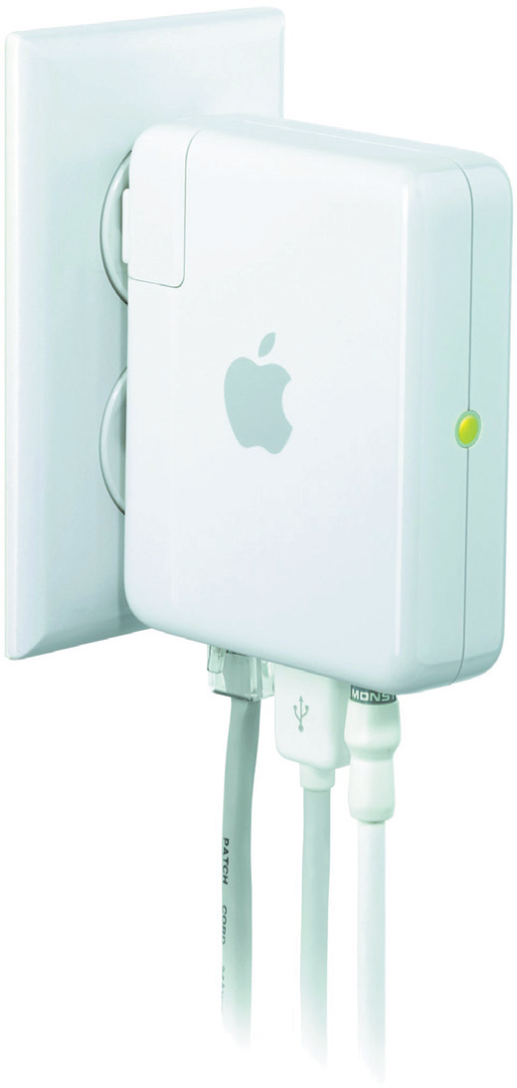
Installing and Configuring Home Networks: Connecting Devices to a Router (cont.)
Notes:
The AirPort Express router can be used for home networks to support devices running iOs, OS X, and Windows. Multiple Ethernet ports enable several devices to access wired Internet connectivity.

Slide 51
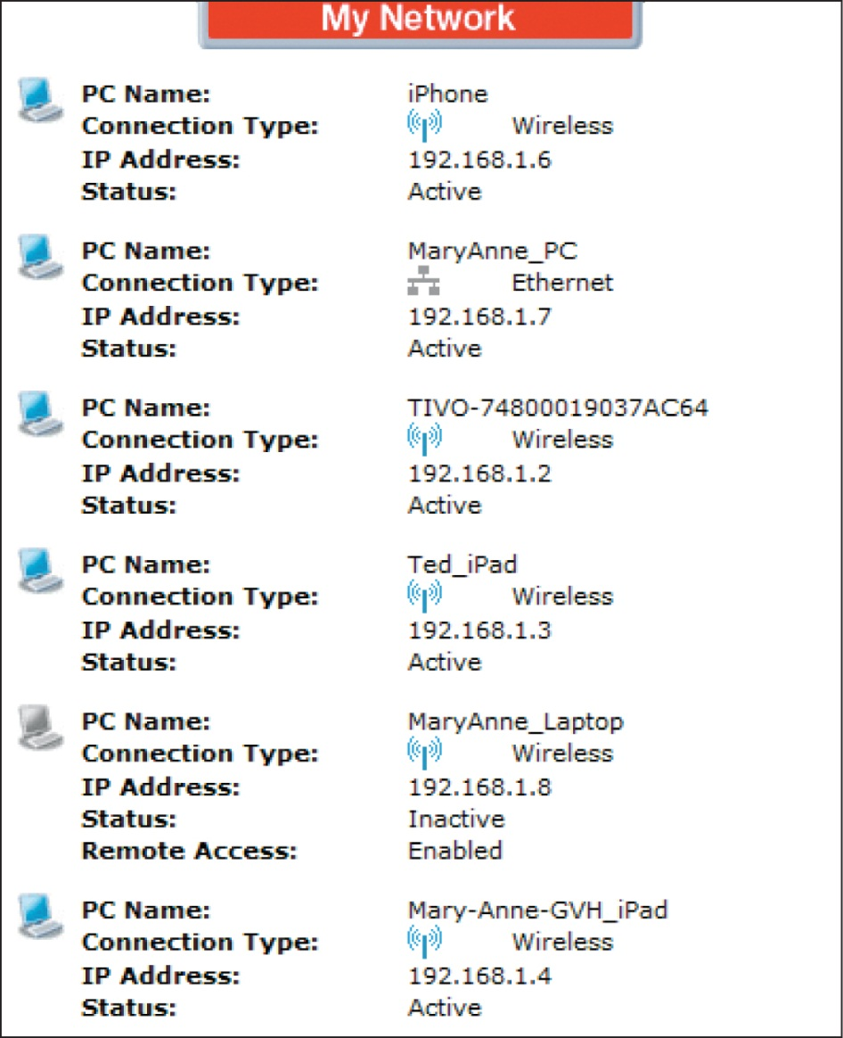
Installing and Configuring Home Networks: Connecting Devices to a Router (cont.)
Notes:
To determine what’s connected to your router, you need to log in to an account associated with your router’s IP address. You can find your router’s IP address on the manufacturer’s website. Once you know it, type it into a web browser. You might need to enter a user name and password, but eventually you’ll get to a configuration page that lists what wired and wireless devices are in your network.
Wired and wireless connections can use the same router.

Slide 52
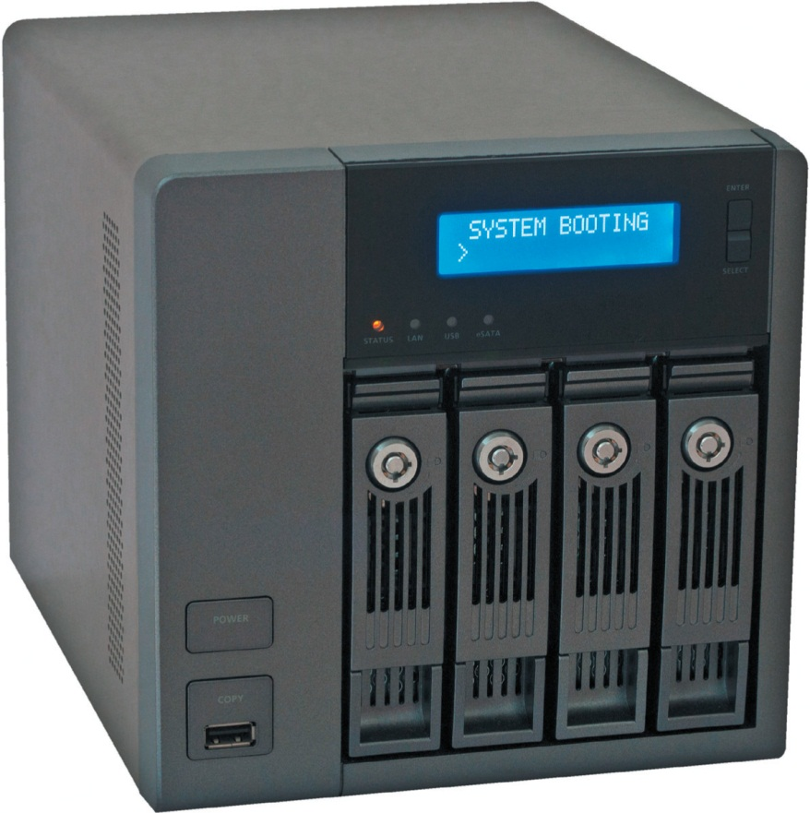
Installing and Configuring Home Networks: Network-Attached Storage Devices
NAS devices
Time Capsule
Notes:
Network-attached storage (NAS) devices are specialized devices designed to store and manage all network data.
NAS devices are now being widely marketed for home networks. You can think of them as specialized external hard drives.
NAS devices connect directly to the network through a router or switch..
For Apple computers, the Time Capsule is a wireless router combined with a hard drive that facilitates the backup of all computers connected to the network. The Time Capsule looks very similar to the AirPort router, and it works in conjunction with the Time Machine backup feature of OS X.

Slide 53
Installing and Configuring Home Networks: Home Network Servers
Home network server
Configured with Windows Home Server
Connect directly as a node
Notes:
A more sophisticated type of NAS device is a home network server. Home network servers are specialized devices designed to store files, share files across the network, and back up files on computers connected to the network.
Home network servers are often configured with Windows Home Server and connect directly as a node. Home servers have more sophisticated functionality than NAS devices and often handle the following tasks:
Automatically back computers
Act as a repository for shared files
Function as an access gateway to allow any computer on the network to be accessed from a remote location via the Internet

Slide 54
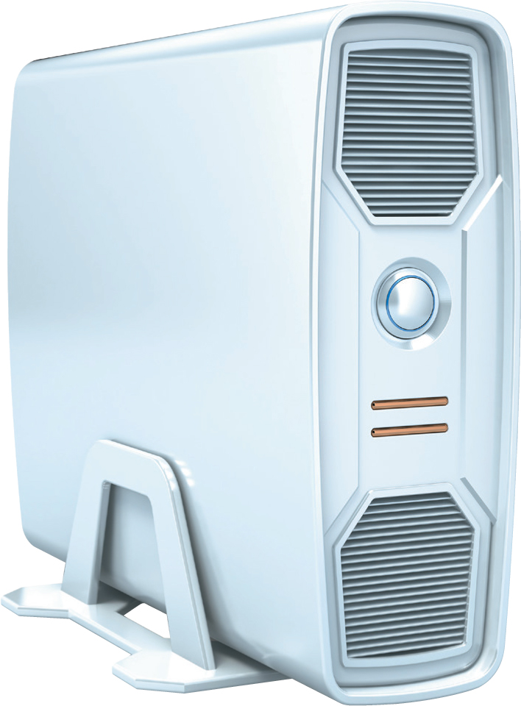
Installing and Configuring Home Networks: Home Network Servers (cont.)
Notes:
Home network servers can perform a variety of tasks that simplify file management on a home network.

Slide 55
Installing and Configuring Home Networks: Digital Entertainment Devices on a Network
Network-ready devices
Wired or wireless connection
Blu-ray players, DVRs, and smart TVs
Notes:
A network-ready device Internet-ready device) can be connected directly to a network, either through a wired or wireless connection. Most game consoles, Blu-ray players, and DVRs, as well as many televisions (smart TVs) and home theater systems, are network-ready. A device that is not network ready requires that the device be connected directly to another computer via a cable on the network.

Slide 56
Installing and Configuring Home Networks: Digital Entertainment Devices on a Network (cont.)
Connecting entertainment
Access and share digital data
Access Internet entertainment content
Play multiplayer games
Notes:
One reason for connecting entertainment devices to your network is to access and share digital content across devices on your network. Connecting these devices to your network also gives them access to the Internet so you can access a lot of entertainment content, including movies, videos, and music available online.
You can also use gaming devices to play multiplayer games with players in the next room or all over the world. The content you access is either downloaded or streamed to your devices. Newer smart TVs and other smart devices are continually adding apps and video services.

Slide 57
Installing and Configuring Home Networks: Digital Entertainment Devices on a Network (cont.)
Blu-ray players
Integrated wireless
LG Smart TV Upgrader
Apple TV
Google Chromecast
Notes:
If you don’t have a smart TV, you can get the same services on your existing television by using a Blu-ray player like the Sony 3-D Blu-ray Disc player. These Blu-ray players feature integrated wireless connectivity to receive streaming media from various ISPs in addition to having high-definition resolution and the capability to display 3-D video.
Some set-top boxes, such as the LG Smart TV Upgrader, also provide the same types of connectivity as a Blu-ray player.
Alternatively, you can uses devices such as Apple TV or Google Chromecast that enable you to send Internet-based media to your traditional TV.

Slide 58
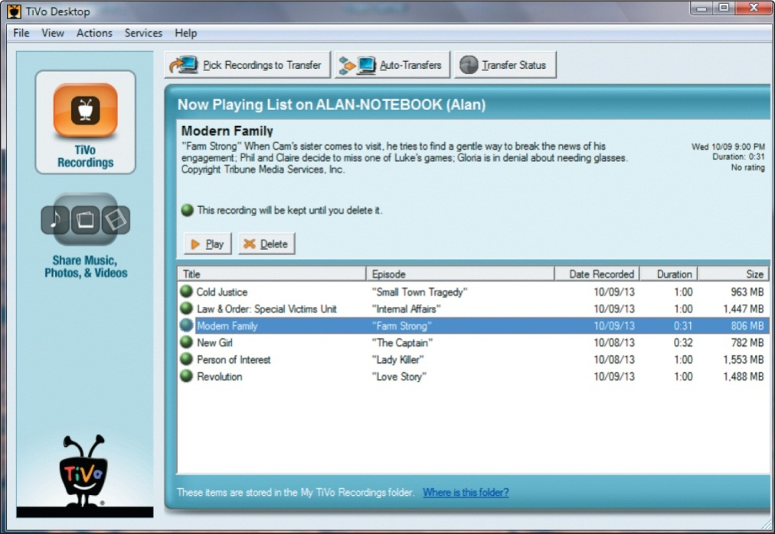
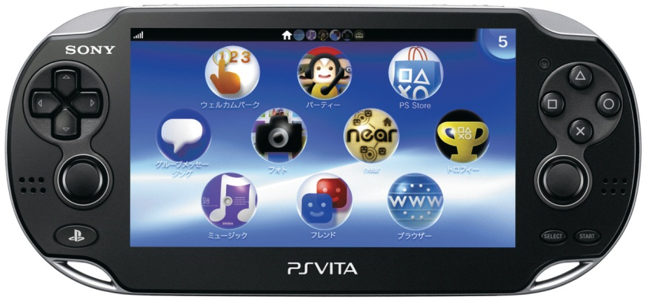
Installing and Configuring Home Networks: Digital Entertainment Devices on a Network (cont.)
TiVo Premiere
PlayStation 4
Notes:
You might have a DVR, like the TiVo Premiere, which you use to record HDTV programs. The TiVo Desktop software, which you can download from tivo.com, lets you transfer shows recorded on your TiVo to your computer or portable devices
Current gaming systems like the PlayStation 4 (PS4) can function as total entertainment platforms when connected to the Internet through your network. The PS4 has a built-in Blu-ray drive and can play Blu-ray discs, DVDs, and music files.
If you have a PS Vita, you can use the application Remote Play to access features on your PS4 from your Vita.

Slide 59
Installing and Configuring Home Networks: Specialized Home-Networking Devices
New digital picture frames
Built-in wireless
Access network and online photos
Receive pictures via e-mail
Notes:
You can use your home network to share photos with a digital picture frame such as the Kodak Pulse Digital Frame that comes with built-in wireless adapters. Featuring a touch-screen interface, this frame can access photos stored on your network or on an online photo-sharing site and display them. You can even set up an e-mail address for the picture frame so that friends and family can e-mail pictures directly to the frame.

Slide 60
Installing and Configuring Home Networks: Specialized Home-Networking Devices
Security
Wireless monitoring cameras
Notes:
You can use your home network to enhance your home security with monitoring cameras that feature wireless connectivity. You can connect these cameras to your network and monitor them through software like the Logitech Alert System.
The software can be configured to alert you via e-mail or text message when the cameras detect movement. Some systems also allow you to receive alerts when there is a lack of movement. This can be useful for monitoring an aging relative or for monitoring the arrival of children coming home from school.

Slide 61
Installing and Configuring Home Networks: Configuring Software for Your Home Network
Before configuring your home network
Make sure all nodes have network adapters
Check wired connections
Connect the modem to the router and to the Internet
Turn on your equipment
Open the Network and Sharing Center
Notes:
Before configuring the computers to run on the network:
Make all nodes have network adapters.
For wired connections, plug in all the cables.
Make sure your modem is connected to your router and that it is connected to the Internet.
Turn on your equipment in the following order:
Modem
Router
Computer and peripherals
Next, open the Network and Sharing Center from the Control Panel:
If it is a wired connection, you should connected.
If it’s a wireless connection, click Connect to a Network in the Network and Internet group of the Control Panel. You will need to enter your passphrase.

Slide 62
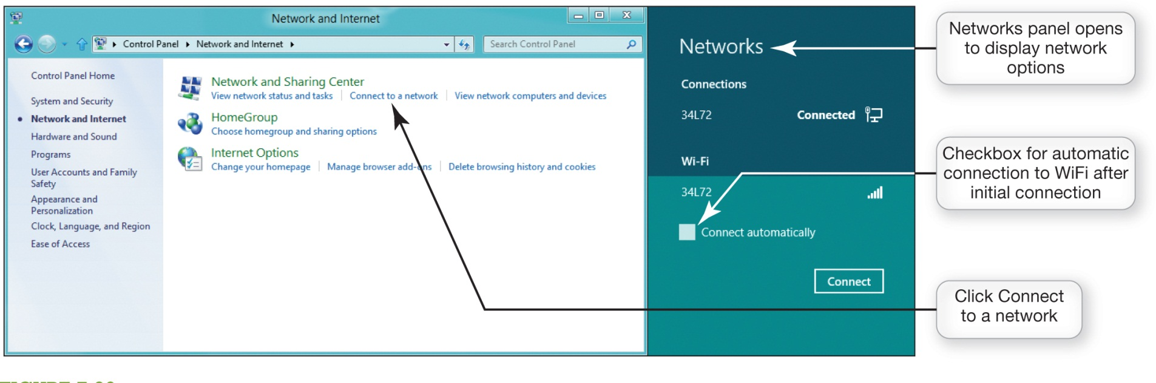
Installing and Configuring Home Networks: Configuring Software for Your Home Network (cont.)
Notes:
Connecting a Windows 8.1 computer to a network for the first time is fairly automated.

Slide 63
Installing and Configuring Home Networks: Configuring Software for Your Home Network (cont.)
Homegroup
Notes:
Windows 7 created a feature known as homegroup that has carried over to Windows 8. The homegroup is a software device that makes it easier to allow computers on a Windows 8 network to share peripherals and information.

Slide 64
Installing and Configuring Home Networks: Configuring Software for Your Home Network (cont.)
Computers with various versions of Windows can coexist on same network
Connecting mobile devices to a wireless network
NIC detects available networks
Notes:
Computers with various versions of Windows can coexist on the same network. Always set up the computers running the newest version of Windows first.
Connecting a mobile device, regardless of its operating system, to a wireless network is an easy process. When you boot up your device, your device will display a list of available networks that the NIC in your device detects. On Macs, the list pops up in the Internet access icon in the system tray to display available networks, or click the Settings charm button in Windows 8 to display network connections.

Slide 65
Installing and Configuring Home Networks: Troubleshooting Wireless Network Problems
Maximum range of 802.11n or 801.11ac is 350 feet
Dual-band N router
Simultaneous support for both 2.4 GHz and 5 GHz
Wireless range extender
Notes:
The maximum range of 802.11n or 802.11ac wireless devices is about 350 feet. Distance from the router or obstacles decrease throughput.
If a node seems slow, repositioning it can affect communication between nodes. If this doesn’t work, move it closer to the router or to another room. If these don’t work, consider using a dual-band N router or adding a wireless range extender.
A dual-band N router allows for simultaneous support for both 2.4-GHz and 5-GHz frequency bands for 802.11n and all prior standards.
A wireless range extender is amplifies your wireless signal.

Slide 66
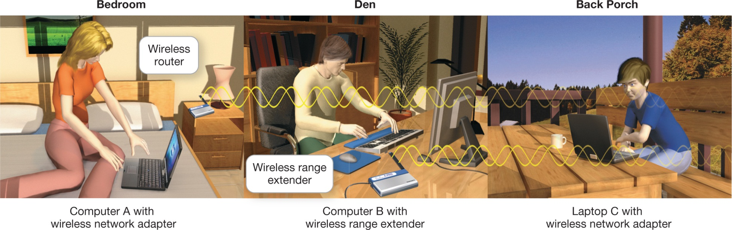
Installing and Configuring Home Networks: Troubleshooting Wireless Network Problems (cont.)
Notes:
Because a wireless range extender is installed in the den, Laptop C on the back porch can now connect to the wireless network.

Slide 67
Securing Wireless Networks
Secure computers connected to Internet
Firewall
Wireless networks have special vulnerabilities
Notes:
All computers that connect to the Internet, regardless of whether they’re on a network, need to be secured from intruders. This is usually accomplished by using a firewall, which is a hardware or software solution that helps shield your network from prying eyes.
Wireless networks present special vulnerabilities; therefore, you should take additional specific steps to keep your wireless network safe.

Slide 68
Securing Wireless Networks (cont.)
Hacker
Piggybacking
Notes:
A hacker is someone who breaks into computer systems to create mischief or steal information. The newer wireless 802.11 networks have wide ranges making it possible for hackers to access your network without your knowledge.
Most wireless network adapters are set up to access the strongest wireless network signal detected. Piggybacking is connecting to a wireless network without the permission of the owner.
If someone is using your network connection, the usage could be slowing down your connection speed. Any cyberattacks or illegal behavior a hacker initiates from your wireless network could get you in trouble with the authorities.

Slide 69
Securing Wireless Networks (cont.)
Precautions to secure a wireless network
Change your network name (SSID)
Disable SSID broadcast
Change the default password on your router
Turn on security protocols
Notes:
To secure a wireless network, you should take these additional precautions:
Change your network name (SSID). Each wireless network has its own name to identify it known as the service set identifier (SSID). Hackers know the default names and access codes for routers.
Disable SSID broadcast.
Change the default password on your router. Use at least eight characters that are a combination of letters, symbols, and numbers.
Turn on security protocols. Most routers ship with security protocols such as Wired Equivalent Privacy (WEP) or Wi-Fi Protected Access (WPA).

Slide 70
Securing Wireless Networks (cont.)
Precautions to secure a wireless network (cont.)
Create a passphrase
Implement media access control
Limit your signal range
Apply firmware upgrades
Notes:
Create a passphrase. The security key or passphrase is the code that computers on your network need to decrypt data transmissions from your network.
Implement media access control. Many routers allow you to restrict access to the network to only certain MAC addresses.
Limit your signal range. Cutting down the power to low or medium could prevent your signal from reaching too far away from your home.
Apply firmware upgrades. Your router has read-only memory software written to it known as firmware. As bugs are found in the firmware manufacturers issue patches. Periodically check the manufacturer’s website for necessary upgrades.

Slide 71
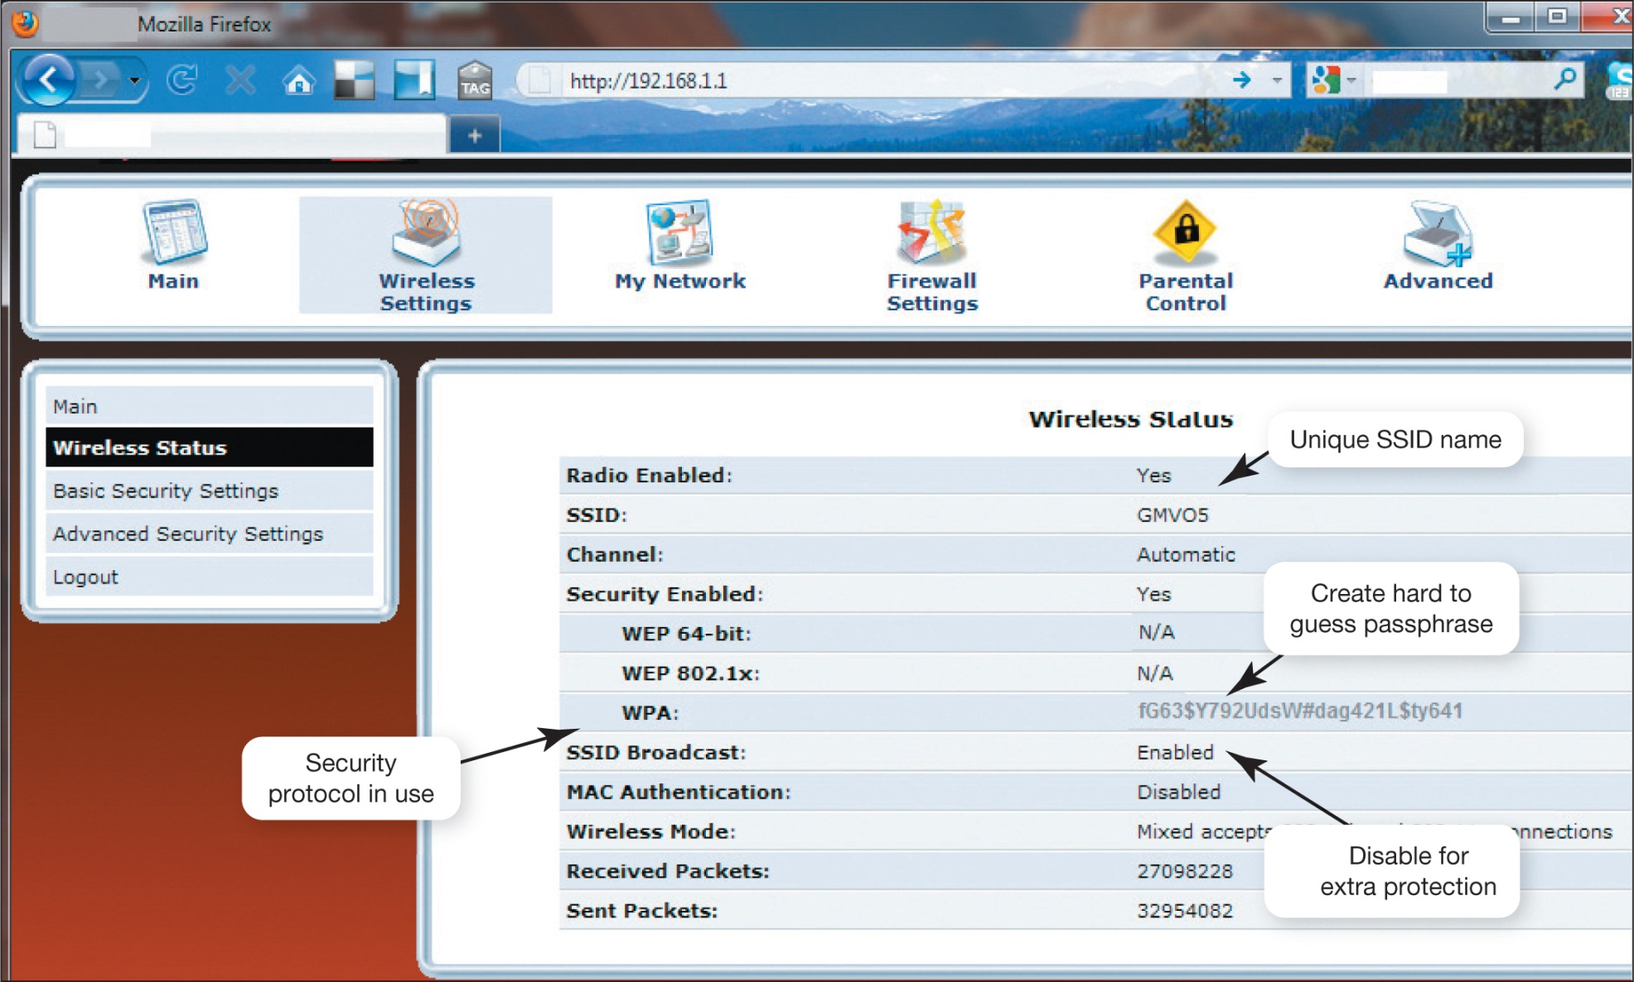
Securing Wireless Networks (cont.)
Notes:
By accessing your router, you can configure the security protocols available on your router and change the SSID.

Slide 72
Chapter 7 Summary Questions
What is a network, and what are a network’s advantages and disadvantages?
Notes:
A computer network is simply two or more computers that are connected using software and hardware so they can communicate. Advantages of networks include allowing users to:
Share an Internet connection
Share printers and other peripheral devices
Share files
Communicate with computers regardless of their operating system
Disadvantages for larger networks are that they require administration and that they may require costly equipment.

Slide 73
Chapter 7 Summary Questions
What are the different ways to classify networks?
Notes:
Networks are classified by administration: (1) Central: A client/server network contains two types of computers: a client computer on which
users perform specific tasks and a server computer that provides resources to the clients and central control for the network. Most networks that have 10 or more nodes are client/server networks. (2) Local: Peer-to-peer (P2P) networks enable each node connected to the network to communicate directly with every other node. Most home networks are P2P networks.

Slide 74
Chapter 7 Summary Questions
Which type of network is most commonly found in the home?
Notes:
Ethernet networks are the most common networks used in home networking. Most Ethernet networks use a combination of wired and wireless connections, depending on the data throughput required. Wired connections usually achieve higher throughput than wireless connections. Wired Ethernet home networks use the gigabit Ethernet standard. Wireless Ethernet networks are identified by a protocol standard: 802.11 a/b/g/n/ac.
802.11ac is the newest standard.
WiGig (802.11ad) is a new wireless link between devices.
WiGig is similar to but faster than Bluetooth.

Slide 75
Chapter 7 Summary Questions
What are the main components of every network?
Notes:
To function, any network must contain a number of components: (1) a means of connecting the nodes on the network (cables or wireless technology); (2) special hardware devices that allow the nodes to communicate with each other and to send data; (3) software that allows the network to run.

Slide 76
Chapter 7 Summary Questions
What are my options for connecting to the Internet?
Notes:
The options for connecting to the Internet include broadband and dial-up. Broadband connections include the following types: cable, DSL, fiber optic, satellite, WiFi, and Mobile broadband .
Dial-up is the cheapest means of accessing the Internet, but it is also the slowest.

Slide 77
Chapter 7 Summary Questions
How do I tell if my home network is up to date, and how do I identify the devices on the network?
Notes:
Most home network routers should support both wireless and wired access to the Internet. For a home network to run efficiently, all nodes such
as NICs and routers should use the same Ethernet standard. The Device Manager utility in Windows lists all adapters installed on your computer.

Slide 78
Chapter 7 Summary Questions
Besides computers, what other devices can I connect to a home network?
Notes:
All devices are connected to your router, either wirelessly or with a wired connection. Wired connections deliver better throughput than wireless. To add ports to your network, you can connect a switch to your router. Network-attached storage (NAS) devices let you store and share data files, as well as provide a central place for file backups. Home network servers can be used instead of an NAS device if your needs require more sophisticated functionality than NAS devices. Connecting digital entertainment devices (such as gaming consoles) lets you stream movies and other entertainment directly from the Internet.

Slide 79
Chapter 7 Summary Questions
How do I configure the software on my computer and set up the devices required to get my network up and running?
Notes:
The latest versions of Windows make it easy to set up wired and wireless networks. (1) Plug in the modem, the router, and cables, then switch on the modem, router, and computers (in that order). (2) Launch the Network and Sharing Center and select the appropriate links for setup. (3) Make sure each computer has a distinct name, and ensure that all computers are in the same homegroup. (4) Devices such as gaming consoles have their own setup procedures for connecting to wireless networks but usually require the same information needed for connecting a computer to a secured wireless network.

Slide 80
Chapter 7 Summary Questions
What problems might I encounter when setting up a wireless network?
Notes:
You may not get the throughput you need through a wireless connection. Therefore, you may need to consider a wired connection for certain devices. Distance from the router, as well as walls, floors, and large metal objects between a device and the router, can interfere with wireless connectivity. To solve connectivity problems, dual-band N routers allow for simultaneous support for devices running on both the 2.4 GHz and 5 GHz frequency bands for 802.11n standards. Wireless range extenders can amplify signals to improve connectivity in areas of poor signal strength.

Slide 81
Chapter 7 Summary Questions
Why are wireless networks more vulnerable to security risks than wired networks, and what special precautions are required to ensure my wireless network is secure?
Notes:
Wireless networks are more susceptible to hacking than wired networks because the signals of most wireless networks extend beyond the walls of your home. Neighbors may unintentionally (or intentionally) connect to the Internet through your wireless connection, and hackers may try to access it. To prevent unwanted intrusions into your network change the default password on your router to make it tougher for hackers to gain access, use a hard-to-guess SSID, disable SSID broadcasting, enable security protocols such as WPA or WEP, create a network passphrase, implement media access control, limit your signal range, and apply firmware upgrades.

Slide 82

All rights reserved. No part of this publication may be reproduced, stored in a retrieval system, or transmitted, in any form or by any means, electronic, mechanical, photocopying, recording, or otherwise, without the prior written permission of the publisher. Printed in the United States of America.
Copyright © 2015 Pearson Education, Inc.

